Slide 1

ASP.NET Page Life Cycle
Part 1 - Overview

Slide 2
Why Should I Care?
Most Important Architectural Concept in ASP.NET
Essential for moving beyond trivial WebForms...
  Complex Interaction between Controls
  Dynamic Controls
  Evaluating Page State
Notes:
Most Important Architectural Concept in ASP.NET. You absolutely must understand the underlying lifecycle to be an effective developer of ASP.NET pages. Can’t be stressed enough.
Sooner or later you’ll need to know whats under the hood (no matter what the Microsoft Marketing Department says). And if you don’t, then sooner or later the framework will reach back and take your head off.

Slide 3
Why Should I Care?
With, not Against the Life Cycle
  Knowing where to put your code
Reduce Maintenance and Headaches
ASP.NET 2.0 Caveats
Notes:
Some of this will be changing with ASP.NET 2.0. I’ll point out what I know of so far. For the most part, the changes that I know of are more syntactic than anything else – generally much less typing. The underlying process is pretty much the same though.

Slide 4
In The Beginning…
HTTP Request arrives at Web Server
IIS turns Request over to ASP.NET Engine
If needed, ASP.NET compiles the requested Page
Control is handed off to the newly compiled Page, and we’re off...
Notes:
First thing that happens: the request is turned over to the ASP.NET engine. There’s a whole pipeline of stages that happens at this point: verifying file access, managing IIS’s session state…
These are interesting things, and we’re not going to be talking about them today.
.aspx page is generated into a Class that inherits from the code-behind class.
This new class is compiled & stored for next time.

Slide 5
Processing Stages
Instantiation
Initialization
Restore State
Raised Events
Save & Render
…On Every Request
Notes:
Page goes through these 5 states, each time a page is requested or a postback occurs.
Instantiate – make a new page object (and all necessary child objects)
Init – set all objects to their start/defined values
Restore State – (if this is a postback) what did the objects look like the last time
Events – handle any event code
Save – write the state back for later
Render – churn out some HTML and send to client

Slide 6
Instantiation
Generate a new Class (if needed)
Class Constructor
  HttpContext.Current
  No Session Available, Yet
Notes:
At this point, ASP.NET has autogenerated and compiled the webform’s class. (to be looked at, in a moment)
ASP.NET creates an instance of this class, via the constructor.
You can write your own constructor – must have no parameters though.
In the constructor you can:
- Can initialize custom properties or objects in the page
- Must use HttpContext.Current to get Context object
- Cannot access Session at all

Slide 7
Instantiation
Control Tree Creation
  CreateChildControls()
  AddParsedSubObject()
ControlTreeExample.aspx
Notes:
CreateChildControls() and AddParsedSubObject() –
Builds the Control Tree of the page – its important to realize that each item or control in the page becomes part of this control tree entity
References:
http://aspnet.4guysfromrolla.com/articles/092904-1.aspx

Slide 8
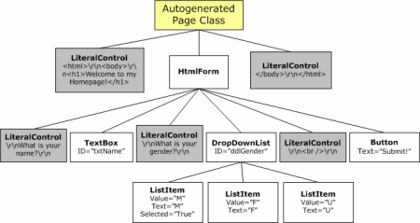

Slide 9
Compiling Pages
Compiled Web Form Example
  Windows\Microsoft.NET\Framework\[version]\Temporary ASP.NET Files
How to Examine Generated Source
Notes:
Looking back 1 minute... Another look at the compiled source
Compiled Web Form: See http://localhost/Lifecycle/Generated.aspx
How to see what gets generated: make sure you’re in debug mode, and add a syntax error to the aspx page.
This page is in “\Windows\Microsoft.NET\Framework\[version]\Temporary ASP.NET Files”

Slide 10
Instantiation
  AddParsedSubObject()
  Control Tree is Created
  Used extensively with Page Mechanics
  Page Template Solutions override this method
    (You probably don’t want to)
Notes:
Method AddParsedSubObject() –
Builds the Control Tree of the page – its important to realize that each item or control in the page becomes part of this control tree entity
This is used later with the ViewState.
Some Page Template solutions override this method. If you’re not writing a page template solution, you probably don’t care about this method.
The control tree is important though.

Slide 11
Initialization
DeterminePostBackMode()
  Postback data from different sources
    Database, XML files, …
    (Advanced Topic)
Notes:
DeterminePostBackMode decides if this form has been posted back or not. Only mentioned here because you could override this method if you wanted to force postback data to come from a different source – like from a database instead of from the form….

Slide 12
Initialization - OnInit
Purpose: Set up any properties that need to exist for the life of the page.
All controls created & initialized
ViewState and Postback values NOT applied yet.
Notes:
OnInit – generally the first method in the lifecycle that you’d find yourself interacting with. At this point the control tree is completely formed, all constituent controls exist and have their default starting values.
Session is now available, ViewState is not.
OnInit’s purpose: to set up any properties that need to exist for the life of your page or control. At this point, your control can safely access its child controls, but cannot access its parent or any other controls in the tree.

Slide 13
Initialization - OnInit
Can create Dynamic Controls here
Can create Page Event Handlers here
Control Tree Safety
  Can safely access any child control, but cannot access parent or other siblings in the control tree.
  InitControl Example
Notes:
Control Tree Safety: This is a general rule. Avoid dependencies where you’re needing to access “up” the tree (via Parent). Sometimes its unavoidable, sometimes it’s completely safe.
Look at the example – ask which will happen first.
The reason it is unsafe here is because the OnInit event fires from the leaves of the control tree back towards the root. So your parents OnInit method hasn’t happened yet, and therefore you can’t rely on the state of your parent.

Slide 14
Restore State
Postback Only
LoadViewState executes throughout Control Tree
  Starts with Page, descends recursively
  Loads ViewState data into each control
  Expects Control Tree to look exactly like it did when the ViewState was last saved.
  Typically Override to manually restore ViewState to dynamically created controls or custom controls.
Notes:
LoadViewState() recurs from the topmost container (page), through each control in the tree. The ViewState and the control tree must be in sync, or you’ll get an Invalid View State exception.
There are some other methods involved with loading View state that you’d override if you wanted the ViewState data to come from a different source.

Slide 15
Restore State
Load Post-Back Data
  Postback Only
  Recur through Control Tree, loading values changed by client
  Loads Client-changed data into controls
  At the end, controls represent the values last seen by the client browser (when the user hit ‘submit’)
Notes:
Any values changes by the client are now updated in the Page controls

Slide 16
Restore State - OnLoad
ViewState of each control is fully restored.
Typically the first place for User’s Code
  Note: PostBack Events haven’t happened yet
  The contents have been changed though
  Clicked, Changed Events
Notes:
Page represents the previous state, updated with changes from Client.
Postback events – Event Changed, Click, etc. have not been processed yet at this point.

Slide 17
Raised Events
Two types of Control Events the Lifecycle deals with:
  Changed Events
  Can have many _Changed events on a page
  No Official Guarantee of Event Order
Notes:
Controls that want to have a chance to evaluate the ViewState, determine if the client has changed the value, must implement IPostBackDataHandler.
From everything that I’ve read, there doesn’t appear to be any guarantee of event ordering; In practice, these events always happen in the order that the controls exist in the control tree – so the textbox event change event happens before the dropdownlist event. In any case it’s a bad idea to write code that explicitly relies on this – that could create some very difficult to maintain code, or some very strange bugs down the road….

Slide 18
Raised Events
Postback Event
  Only one per form cycle, generated by the control that submitted the form
    Button, LinkButton
  No Official Guaranteed Order
  Simple.aspx
Notes:
Controls that are able to post the form need to implement IPostBackEventHandler.
Some documentation suggests that theres nothing that says the PostBack event has to happen AFTER the

Slide 19
PreRender
Last Chance to Safely Alter State
Can Examine the Finished Product
  Last Minute Changes
  MultiDropDownList.aspx
Notes:
Everything has happened on your page. You want to examine the finished product and make any final changes.
“This is a good time for controls to perform any last minute update operations that need to take place immediately before the view state is saved and the output rendered.”

Slide 20
SaveViewState
executes throughout Control Tree
  Each control writes its state back into ViewState.
  Order must match up with LoadViewState on the next page cycle.
  Only called on Controls where
  EnableViewState = True
    Viewstate is Expensive!
Notes:
SaveViewState must mirror LoadViewState or you get InvalidViewStateExceptions

Slide 21
Save and Render
SavePageStateToPersistenceMedium
Serializes the ViewState to a hidden field
    Or, write ViewState to somewhere else
Base64 Encoded String
  ViewStateDecoder.exe
Notes:
if you wanted to write the viewstate to somewhere exotic, SavePageStateToPersistenceMedium is where you’d do that.
The regular PersistenceMedium is a Base64 encoded string. See tools like ViewStateDecoder to pick apart ViewState and see what’s in there.

Slide 22
Render
Each Control writes it’s HTML to a Stream
Final HTML Product
Notes:
Recursively walk through the control tree, each control writes itself out to the output stream. This is the final HTML that will be sent to the browser.
Since we’re going in the order of the control tree, the resulting HTML stream will make sense to the client.
At this point, the state of the controls has been written out to viewstate. Do not change any state here – this page is done processing.

Slide 23
Unload
HTML Has been sent to Browser
Clean up any unmanaged resources
  Unregister Event Handlers, if needed
  Can’t affect Client HTML (it’s gone)
Notes:
An Event Handler Problem: An object stored in Session, with Events. Page registers for events, but never unregistered for events. Page is discarded, but never freed since the object in session has a delegate reference…

Slide 24
Dispose
ASP.NET calls Dispose() on base class, recurs through Tree
Follows the IDisposable pattern
Typically not overridden in Pages

Slide 25
Unload vs Dispose
Pages Unload, Controls Dispose
Main Reason: Safety
  Page orchestrates unloading
  No Processing in Dispose method!
  That’s what Unload is for – called by ASP.NET, before Disposal occurs, so ControlTree is still viable
Notes:
Page objects should implement Unload to clean up any unmanaged resources (if needed!).
Control object use Dispose to clean themselves up.
In Dispose: remember that a control’s peers in a page may already have been Disposed, and it is unsafe to try to access those peers – that’s what Unload is for.
There are a whole class of bugs you can end up with if you mess up the unload vs dispose code, mostly involving bad things with the garbage collector

Slide 26
Summing Up
Each Page Request…
  Creates an Object
  Loads Values
  Runs Some Code
  Generates HTML
  …and then throws that Object away.
Questions
Notes:
Alternative to this is to use ASP.NET server-cache. Which is supposed to be more advanced in 2.0

Slide 27
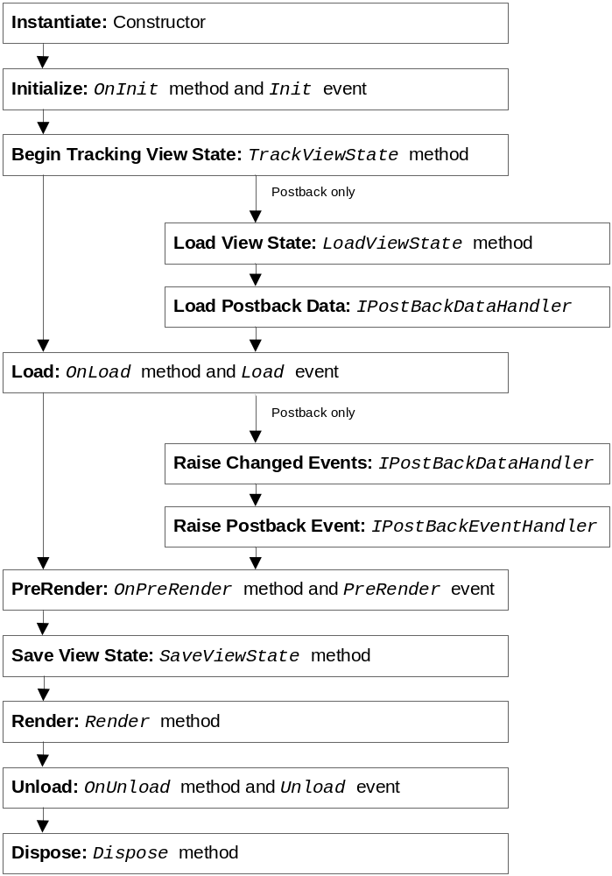
Notes:
This is from Developing Microsoft ASP.NET Server Controls and Components, pg 175
We’re going to gloss over a few of these events; there is some information in MSDN if you end up needing them, to design custom controls for example.
Will be dealt with more in the next session.

Slide 28
Other References
Developing Microsoft ASP.NET
Server Controls and Components
  Nikhil Kothari & Vandana Datye, MSPress
Dynamic Web Controls, Postbacks, View State http://aspnet.4guysfromrolla.com/articles/092904-1.aspx
  Scott Mitchell, 4 Guys From Rolla
One Day in the Life of an ASP.NET Web Page:
http://msdn.microsoft.com/library/default.asp?url=/library/en-us/dnaspp/html/aspnet-pageobjectmodel.asp
  Dino Esposito, Wintellect, MSDN
Page Events: Order and Postback: http://aspalliance.com/articleViewer.aspx?aId=134&pId=
  Paul Wilson, ASP Alliance

